Slide 1
Feature Engineering, Imputation, and Scaling
CS3300 Data Science
RJ Nowling

Slide 2
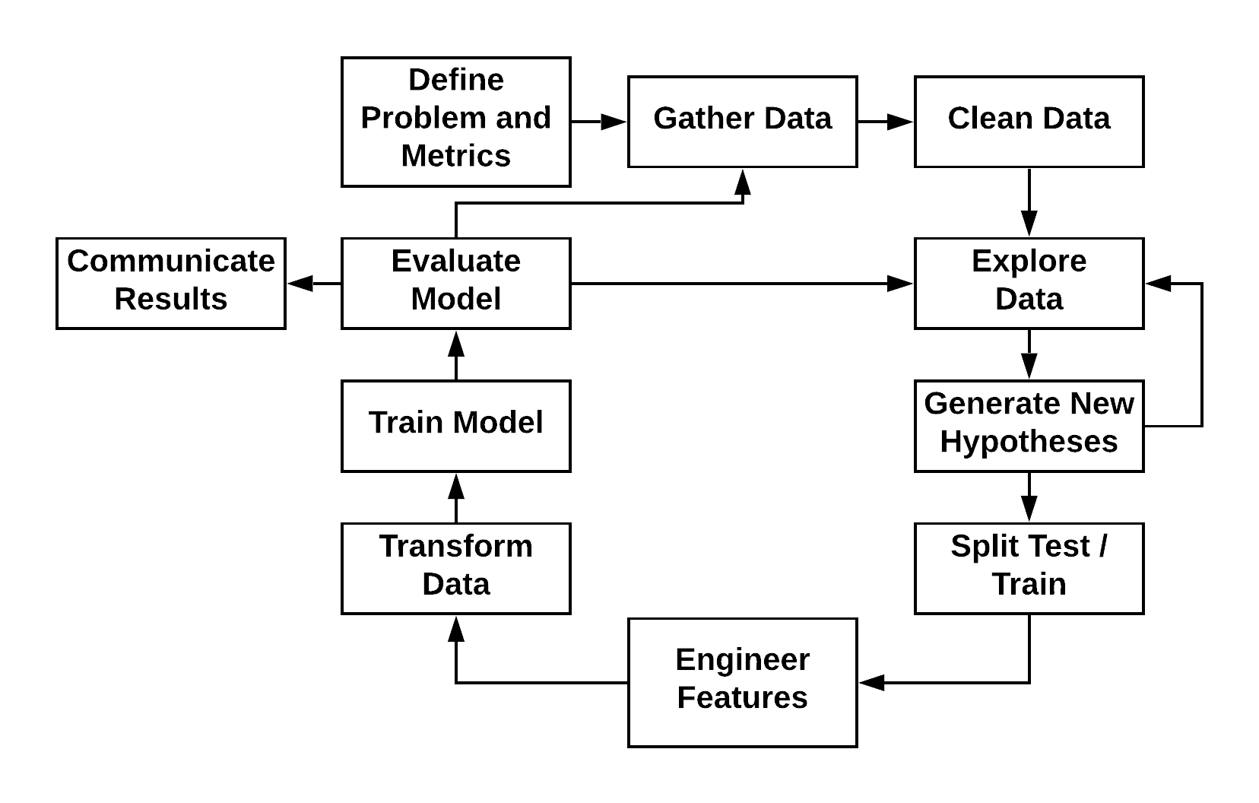
Machine Learning Process

Slide 3
Feature Engineering
Machine learning algorithms expect a matrix of variables
Variables called features
All features must be floating-point numbers
Feature engineering is the process of creating features from our data
Numerical representations of variables
Create new features from existing variables

Slide 4
Numerical Data
Examples: a person's height, square footage of a building, petal width
Each of these can be represented as a single numerical variable
Very little feature engineering to do

Slide 5
Boolean Data
Booleans can be presented as floating points numbers with values of 0 and 1
Boolean columns may need to be converted to floats: df["my_column"] = df["my_column"].astype(np.float32)

Slide 6
Categorical Variables
Categorical variables need to be represented numerically
Common mis-practice is to represent categories as a single numerical variable:
1 – Red
2 – Green
3 – Blue
The problem is that it implies an ordering which is not appropriate
distance(Blue, Red) = 2
distance(Blue, Green) = 1

Slide 7
Categorical Variables
Is it better to use one-hot encoding:
A separate numerical variable is created for each category
1 indicates which category applies
Only one category can be present in a single record so only one of the variables has a 1
distance(Blue, Red) = 1
distance(Blue, Green) = 1
Red | Green | Blue
1 | 0 | 0
1 | 0 | 0
0 | 0 | 1

Slide 8
Categorical Variables
Pandas has utility functions that can create dummy variables for categorical variables: df["beds_cats"] = df["beds"].astype("category") dummies = pd.get_dummies(df["beds_cats"], prefix="beds_cats") df = df.merge(dummies, left_index=True, right_index=True)

Slide 9
Encoding Integers as Categories
It can be helpful to encode certain integers as categories
Number of bedrooms
Number of bathrooms
Day of the week
Why? Let's assume the average value of a house
Increases by $20k when you got from 2 bedrooms to 3
Increases by $40k when you go from 3 bedrooms to 4
This is a non-linear relationship – it may be due to other factors like larger houses are in wealthier areas
In linear models, we approximate non-linear relationships by treating such variables as categorical

Slide 10
Dates and Times
Pandas can identify date and time strings in certain specific formats but often times real data has slight variations
The Python datetime.datetime.strptime() function can be used to parse a date time string and return a DateTime object.
You probably already did this during the data cleaning steps.

Slide 11
Dates and Times
We can engineer a few features from Date or DateTime objects
Convert to Unix epoch to get a single numerical value representing progression of time df["timestamp"] = df["datetime"].map(lambda dt: dt.timestamp())

Slide 12
Dates and Times
Often, we not interested in absolute time but periods of time
Hour of the day
Day of the week
Month of the year
Season (summer, fall, winter, spring)
Machine learning models cannot infer periodicity, so we have to manually engineer features

Slide 13
Dates and Times
Hours: df["hour_of_day"] = df["datetime"].map(lambda dt: t.hour)
Day of the week: day_of_week = df["datetime"].map(lambda dt: dt.weekday())

Slide 14
Dates and Times
Month of the Year: df["month"] = df["datetime"].map(lambda dt: t.month)

Slide 15
Dates and Times
Hour of the day may be too granular. You want periods of the day:
Early morning – midnight to 8 am
Morning – 8 am to noon
Afternoon – noon to 5 pm
Evening – 5 pm to midnight

Slide 16
Dates and Times
The day of the week will be returned as an integer. It can be useful to make it categorical: day_of_week = day_of_week.astype("category") dummies = pd.get_dummies(day_of_week prefix="day_") df = df.merge(dummies, left_index=True, right_index=True)

Slide 17
Dates and Times
def to_periods(hour): if hour < 8: return 0 elif hour < 12: return 1 # 5pm, 24 hour time elif hour < 17: return 2 else: return 3 df["periods"] = df["datetime"].map(lambda dt: to_periods(dt.hour))
And then make it categorical.

Slide 18
Text Data
Dear Class, I've uploaded the new homework to D2L. It's due on Monday. I'm looking forward to seeing your solutions! RJ
?
[0, 1, 0, 0, 0, 1, 1, 0, 0]

Slide 19
Bag of Words Model
The simplest approach is a bag of words model
We keep track of how many times each word appears in each document
Each word count is stored as a separate column
Some variations:
Pre-process vocabulary to perform "stemming"
Binary (absence / presence) instead of counts
Weight the words based on document frequency (e.g., rare words get high weights, common words get lower weights)

Slide 20
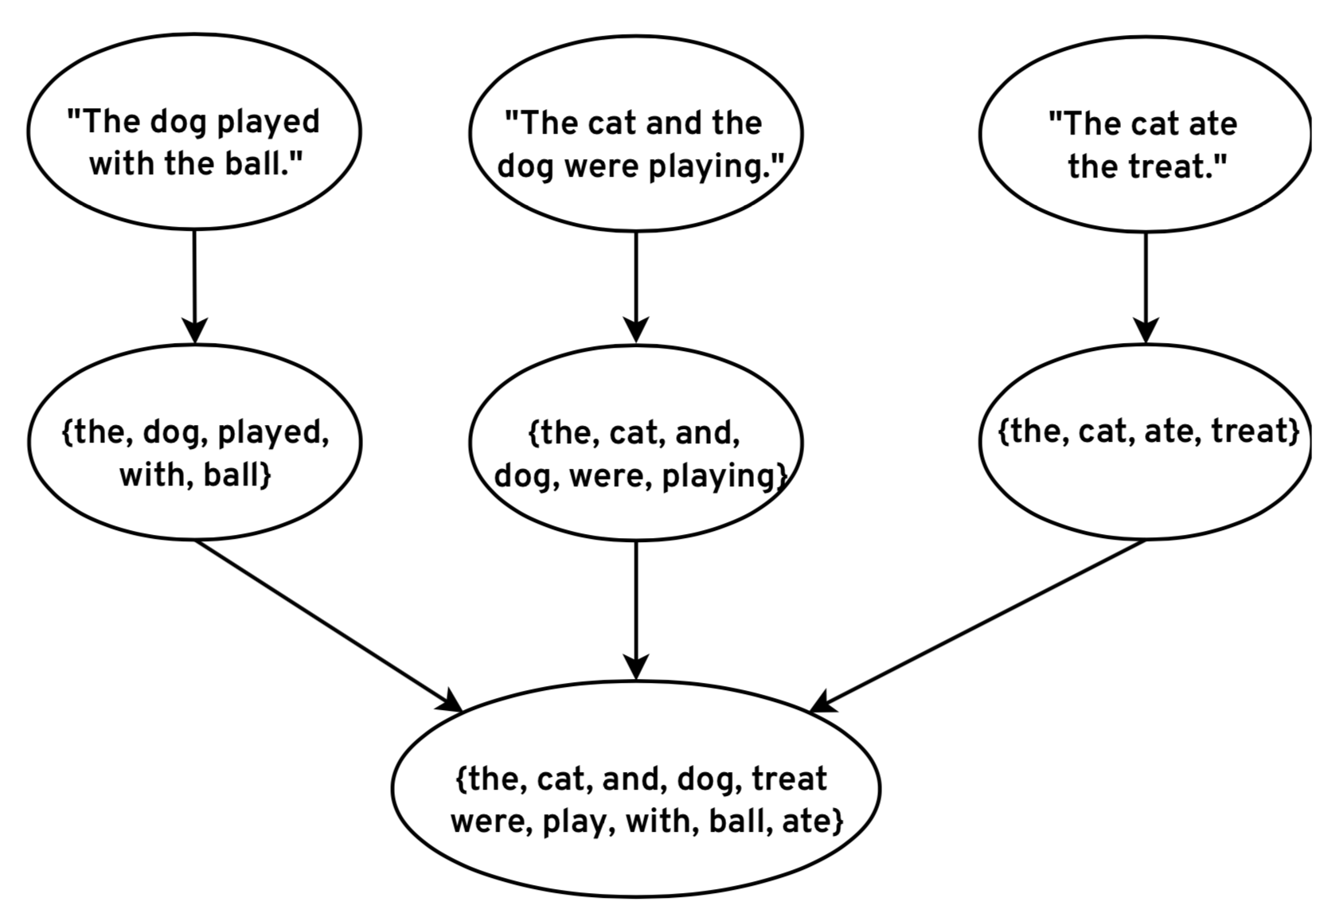
Extract Vocabulary

Slide 21
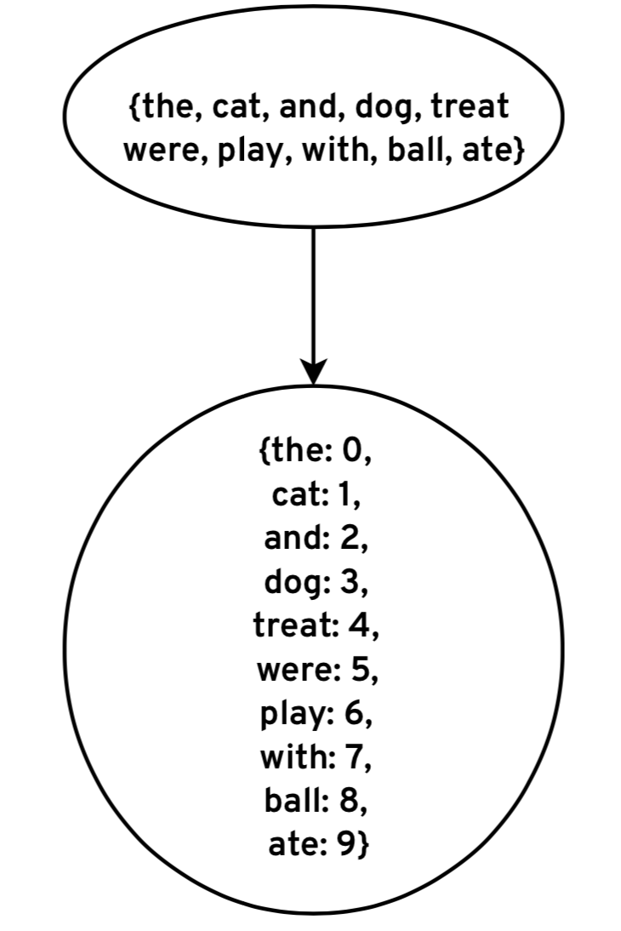
Map Words to Column Indices

Slide 22
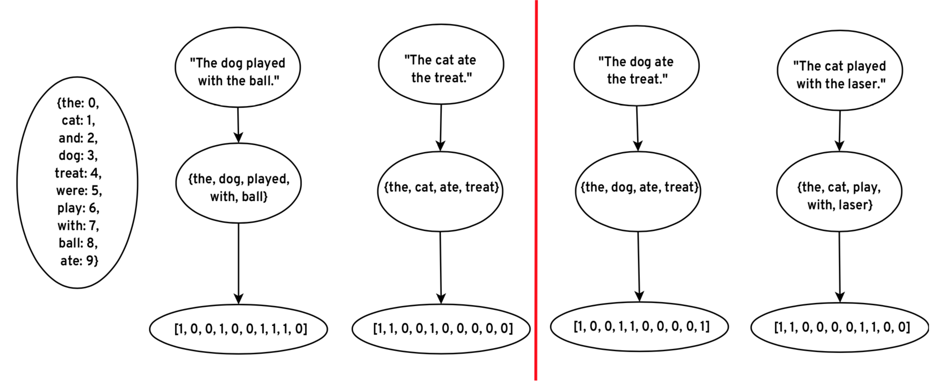
Encode Features

Slide 23
Encode Features

Slide 24
Machine Learning Process

Slide 25
Missing Data and Imputation
This is where we deal with missing data
For numerical features, missing data is represented as NaNs
Software will crash when you attempt to do math with NaNs
For categorical features, all dummies are 0 – no problems
We have to maintain our experimental setup:
Training the imputer on training set records with known values
Impute the missing values in the training and testing sets with that average value

Slide 26
Imputation: Mean or Mode
A simple imputation strategy
Calculate the mean, median, or mode of known values
Replace missing values with calculated value
Tends to be safe in that imputed values will not bias ML models
Most common practice
May not be appropriate:
e.g., using an average birth year for for historical figures

Slide 27
SimpleImputer
from sklearn.preprocessing import Imputer
imputer = Imputer()
train_df["my_column"] = imputer.fit_transform(train_df["my_column"])
test_df["my_column"] = imputer.transform(test_df["my_column"])

Slide 28
Imputation: Nearest Neighbor
More complex strategy
Find similar records using other fields with known values
Use known values from similar records to impute missing value
Not many good (robust) implementations available
May fail when a large number of records have missing values
Complex
Requires transforming data (feature engineering, scaling) to work well
Basically doing machine learning at that point

Slide 29
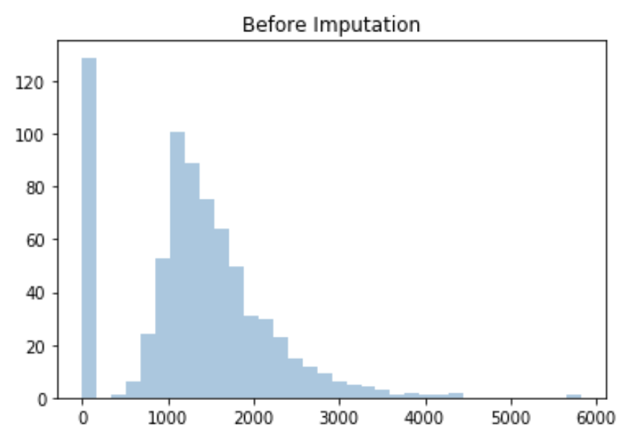
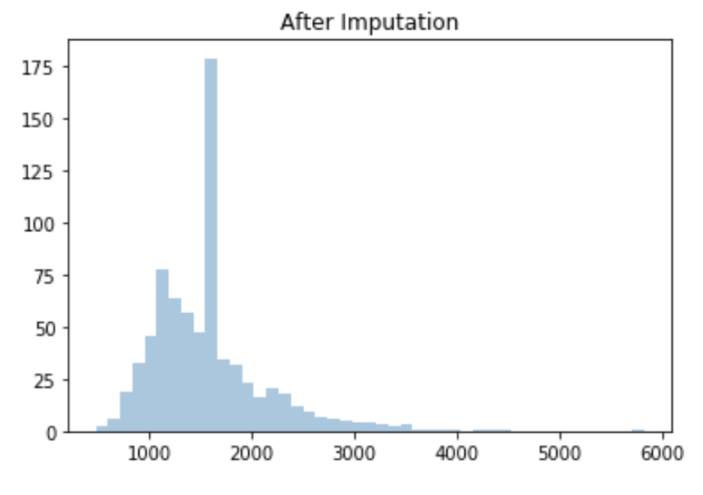
Imputing Square Footage

Slide 30
Machine Learning Process

Slide 31
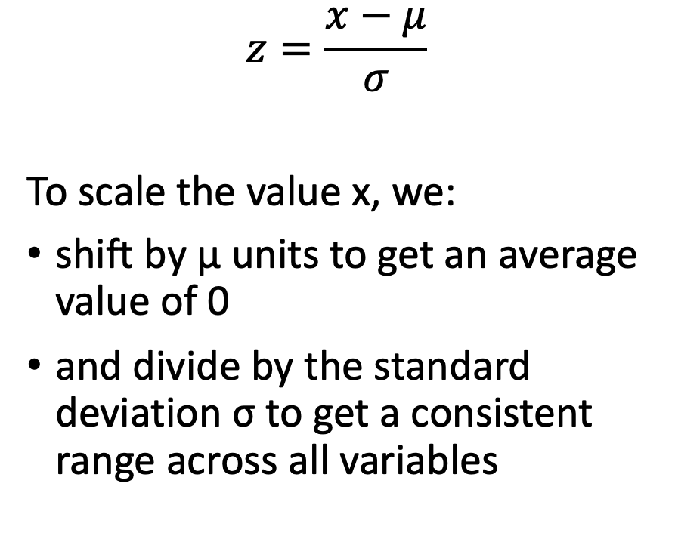
Scaling
Many machine learning algorithms do better when variables have:
the same ranges
an average value of 0
We can scale the values of the variables without changing their overall distribution
$$z=\frac{x−μ}{σ}$$
To scale the value x, we:
shift by μ units to get an average value of 0
and divide by the standard deviation σ to get a consistent range across all variables

Slide 32
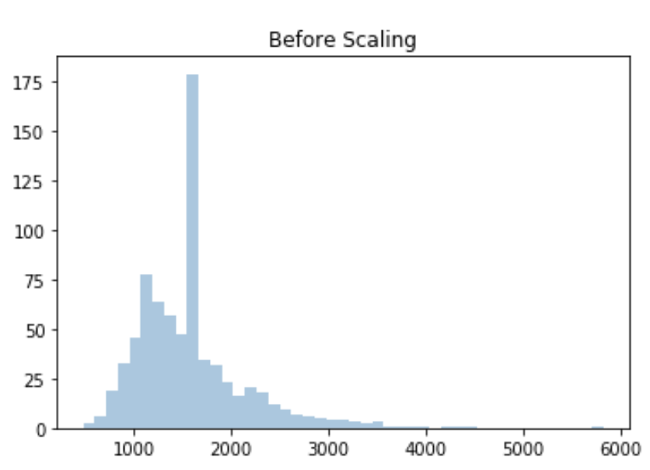
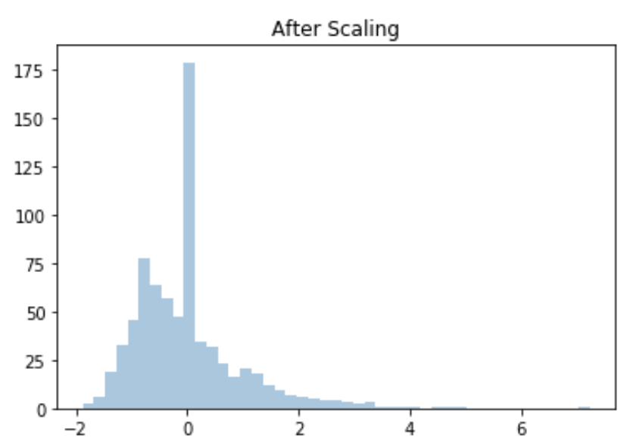
Scaling Square Footage

Slide 33
Scaling
from sklearn.preprocessing import StandardScaler
scaler = StandardScaler()
train_df["my_column"] = scaler.fit_transform(train_df["my_column"])
test_df["my_column"] = scaler.transform(test_df["my_column"])

